Slide 1

Lilly’s Story
DO NOT MAKE FASHION THAT WAY
READING

Slide 2

Lilly is 17 years old. She lives in Guayaquil with her family.
Lilly is a fashion lover.
Her hobby is shopping.

Slide 3

There are a lot of clothes in her closet like:
Skirts
Sportswear
Blouses
Coats
Jeans and pants

Slide 4

Lilly has a lot of sportwear. But, she always wears the same one.

Slide 5

Lilly’s closet
She has many sports clothes.
Shorts
Sports tops
Leggins
Sweatshirts
She is a fan of sports brands like:
Puma
Nike
Rebook

Slide 6

Lilly frequently buys her clothes in San Marino and Mall del Sol.
Lilly’s favorite stores are located in these malls:
In San Marino Shopping:
Zara
Pull & Bear
Bershka
Mango
In Mall del sol Shopping:
Forever 21
Tennis
Marathon

Slide 7


Every afternoon Lilly reads magazines.
The news of companies dedicated to making fast clothes appeared in one of them.
The characteristics of the companies were:
Labor exploitation.
Children working.
Use of toxic products.
Water contamination.
Environmental pollution.

Slide 8

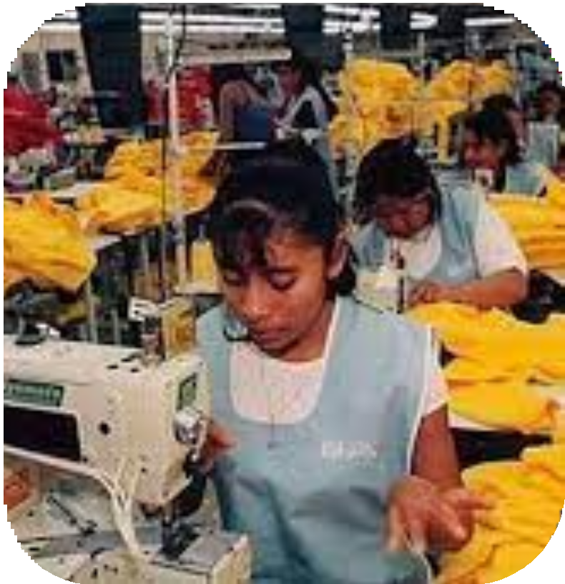
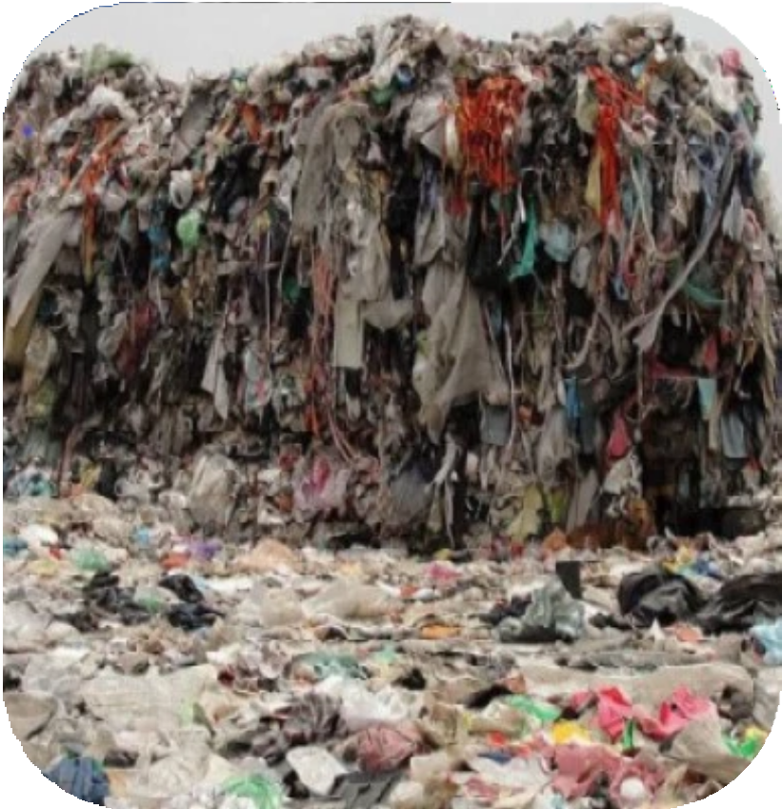





Lilly was surprised because all of her clothes are from the stores that involved in this problema.

Slide 9

This news helped her change habits of buying fast fashion clothes.
Now she prefers to buy second-hand clothes.

Slide 10
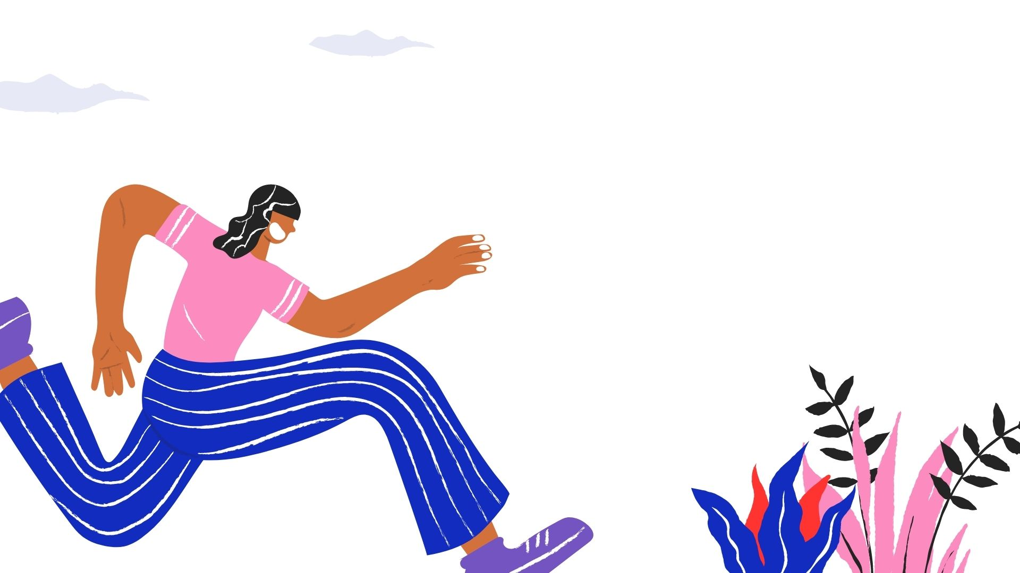
Remember...
You can dress cool, cheap and help the environment.

